Slide 1

Agile 101

Slide 2

40%
30%
What you think you need upfront
Agile
What was valuable
New req’s added
Big Everything Up-Front
60%
30%
20%
£
Notes:
Big Everything Up Front

Slide 3
Building the right thing +
Building it right
Iterative Approach (feedback loops)
Continuous Delivery
On-site Customer
Collocated / Cross Functional Teams
Showcases
Retrospectives
Big Visible Charts
Adaptive Planning
Working software
Continuous Integration
Refactoring
Automated Testing
Test Driven Development
Pair Programming
Collective Code Ownership
Daily stand-ups
…plus many more!

Slide 5
Building the initial platform
£
Diminishing Returns
Added
Value
MVP

Slide 6
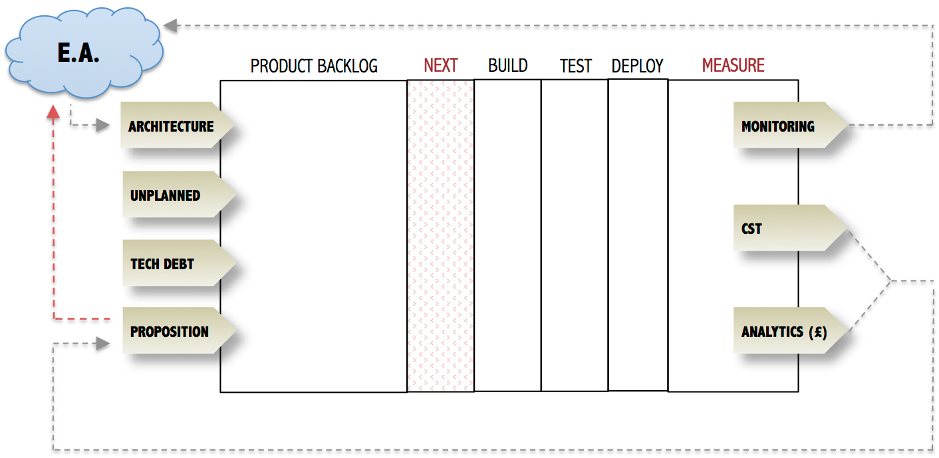
Product Lifecycle – Business As Usual
Inception

Slide 7
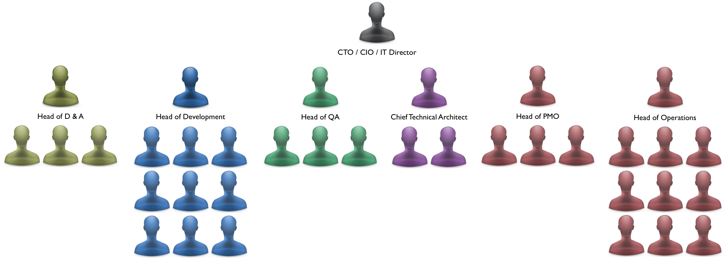
Waterfall Org Structure

Slide 8
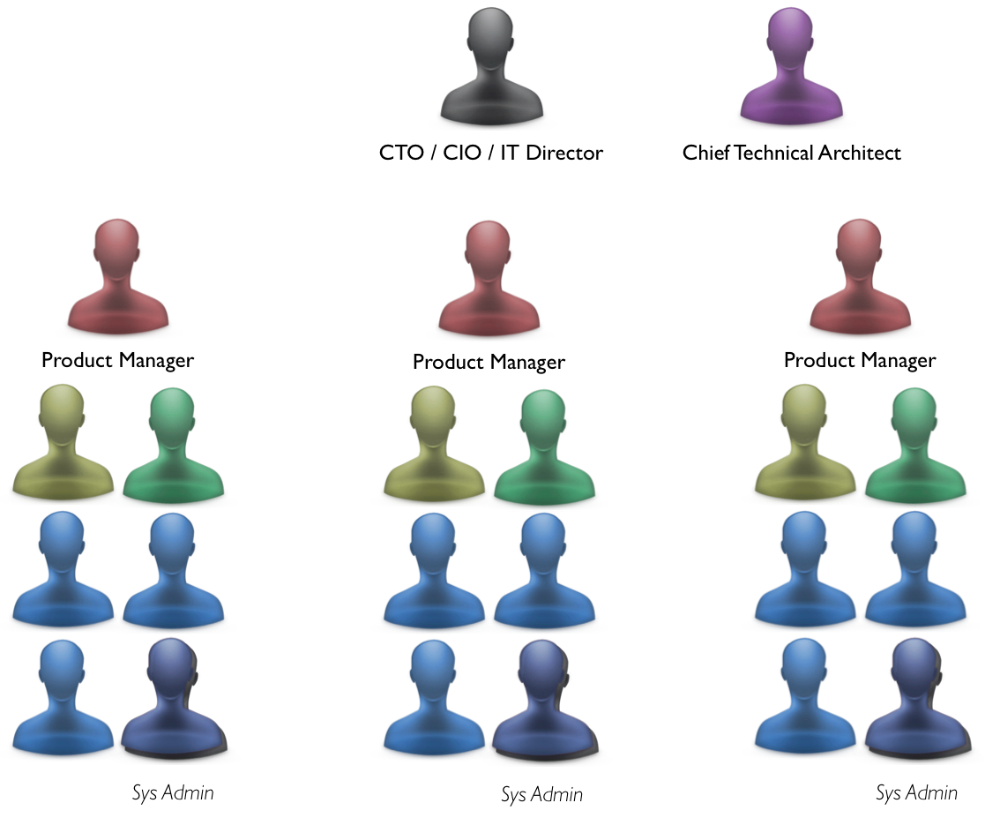
Agile Org Structure

Slide 9
Thank You!

Slide 10
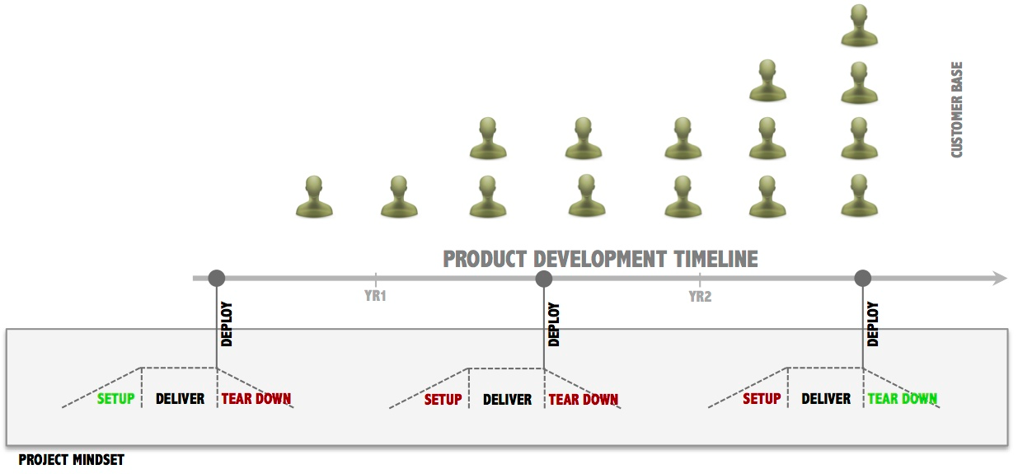
The problem with software projects

Slide 11
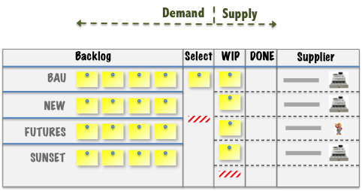
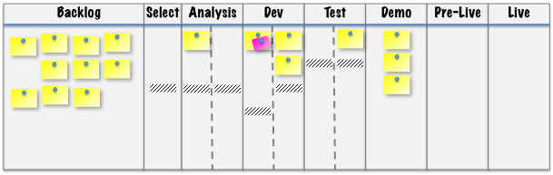


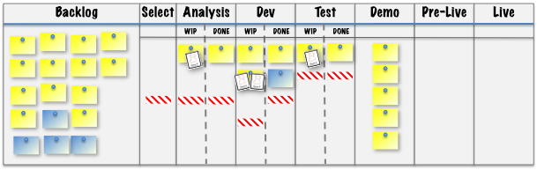

Enterprise Architecture
Product Team A
Product Team B
We need a single view
of the customer
Customer
XYZ Corp

Slide 12
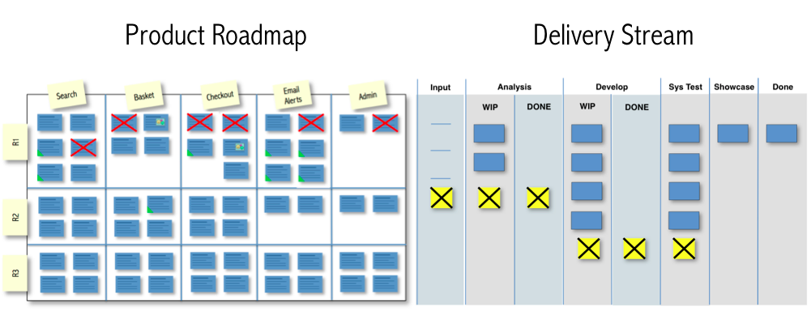

Slide 13
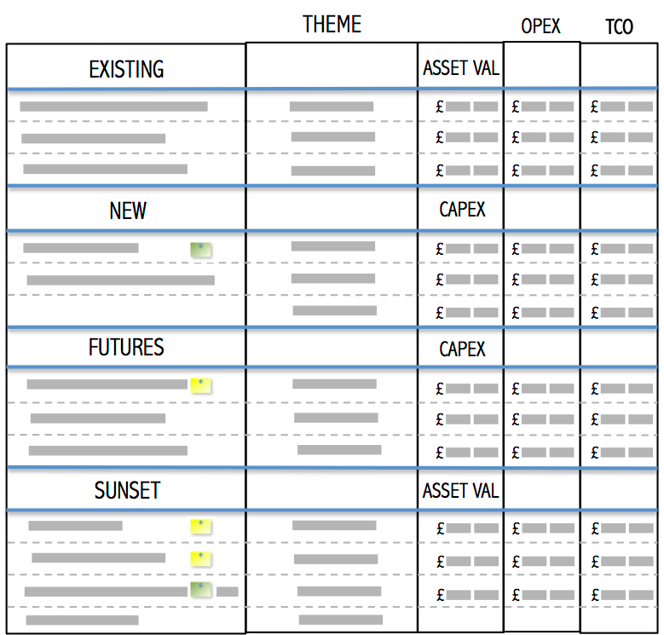
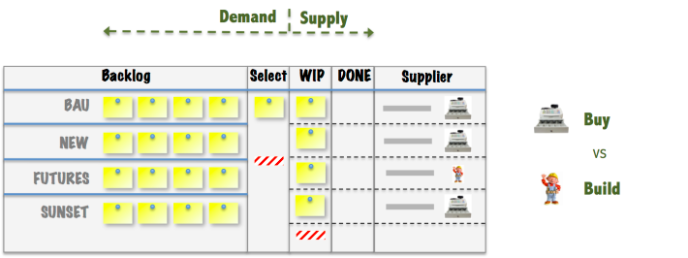
Technical Portfolio Mgmt

Slide 14
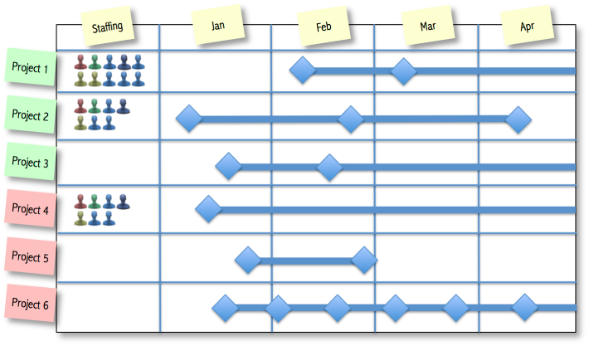
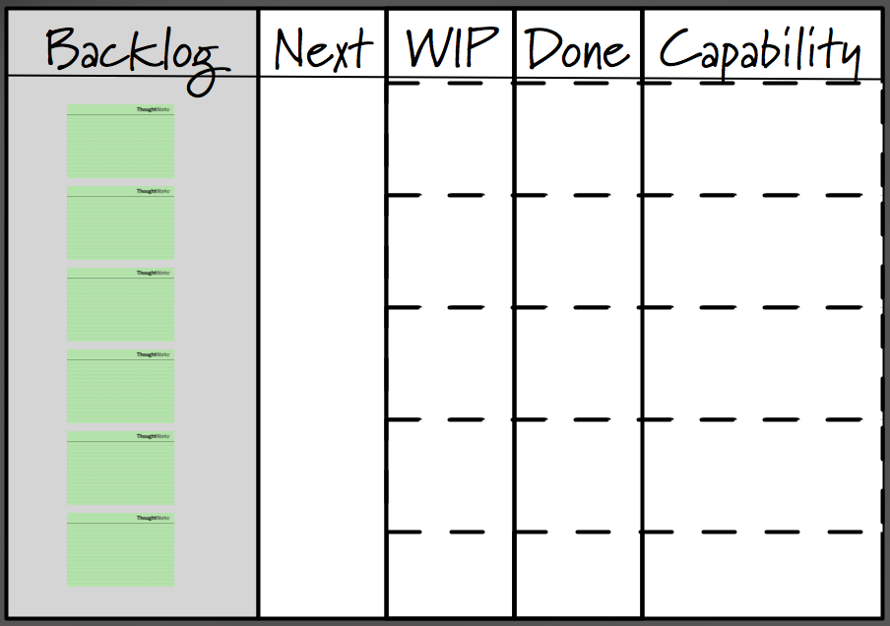
‘Business’ Portfolio Mgmt

